Slide 1



Goodcabs Insights 360
Ankit Rai
Data Analyst

Slide 2

Background
Goodcabs, a cab service company established two years ago, has gained a strong foothold in Indian market focusing on tier 2 cities. Unlike other cab service providers, Goodcabs is committed to supporting local drivers, helping them to make a sustainable living in their hometowns while ensuring excellent service to passengers. Goodcabs has set ambitious targets for 2024 to drive growth and improve passenger satisfaction. The Chief of Operations, Bruce Haryali ,immediately wanted analysis of company’s dataset to know about current growth.

Slide 3

Agenda
Problem Statement
Goal
SQL in Action
Dashboard Showcase
Insights
Recommendations

Slide 4
Problem Statement
GoodCabs has set ambitious growth goals for 2024, including increasing ride volumes, enhancing customer satisfaction, and boosting revenue. However, there is a need for detailed analysis to track progress, identify areas of underperformance, and uncover trends impacting success. The challenge is to analyze a dataset of 426,000 trips over six months across 10 cities to gain insights into market demand, city-specific performance, and the effectiveness of promotional campaigns.

Slide 5
Goal
My goal is to analyze the company’s performance data to see how well it has met its
growth targets for the year. I aim to uncover actionable insights by identifying gaps, analyzing trends, and highlighting underperforming areas. These insights will guide strategic decision-making, enabling the optimization of operations and refinement of strategies to align with the company’s growth objectives.

Slide 6
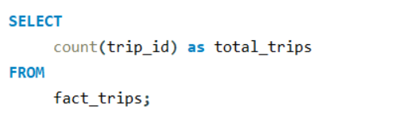
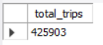
SQL in Action
1.Total Trips
Output:

Slide 7
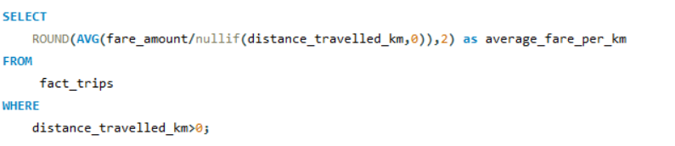
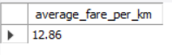
2.Average Fare per km
Output:

Slide 8
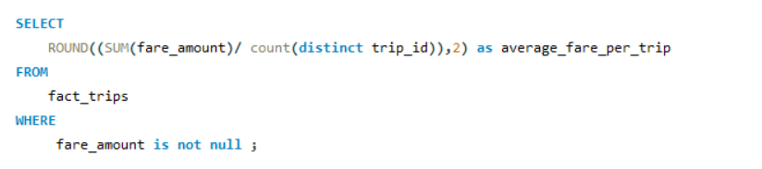
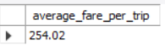
3.Average Fare per trip
Output:

Slide 9
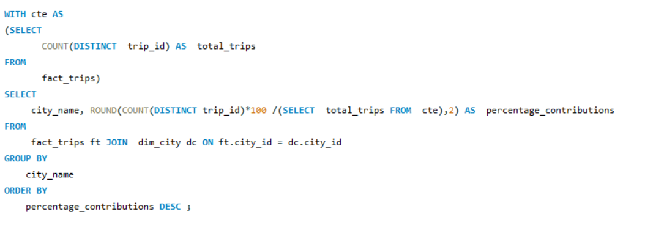
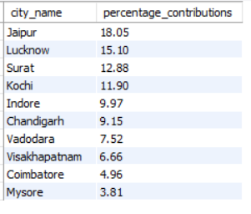
4.Contribution % Of Each City To Total Trips
Output:

Slide 10
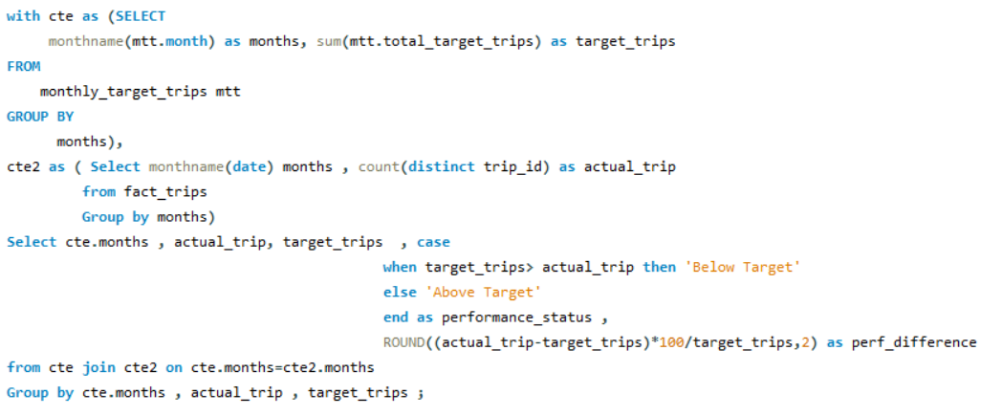
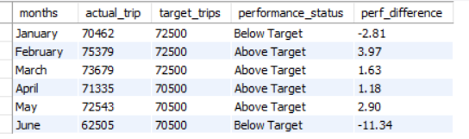
5.Monthly actual and target total trips
Output:

Slide 11
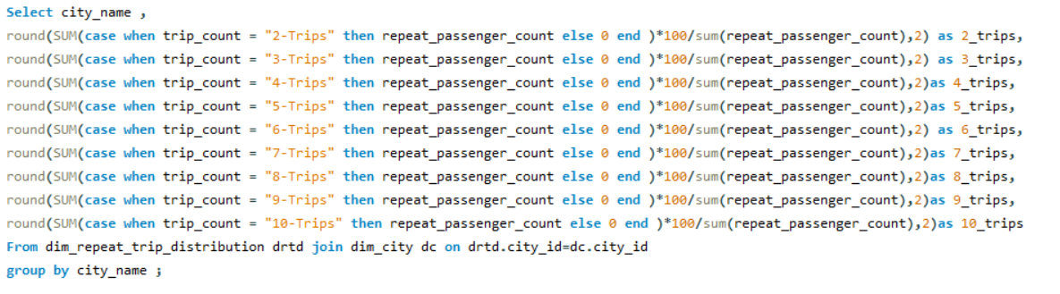
6.City Level Repeat Passenger Trip Frequency Count %

Slide 12
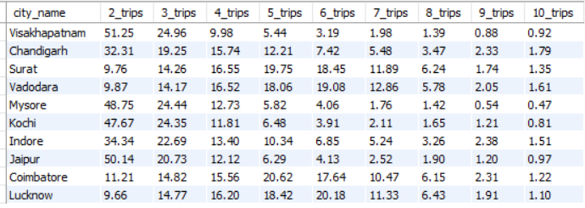
Output:

Slide 13
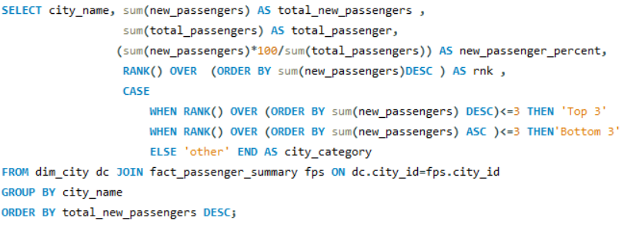
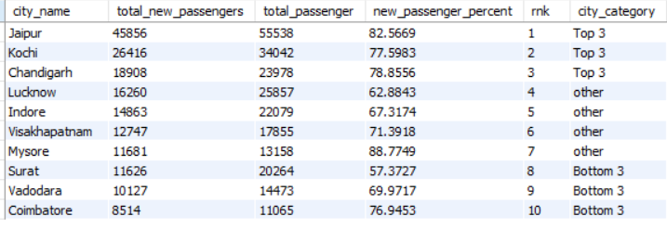
7.Cities With Highest And Lowest Total New Passengers
Output:

Slide 14
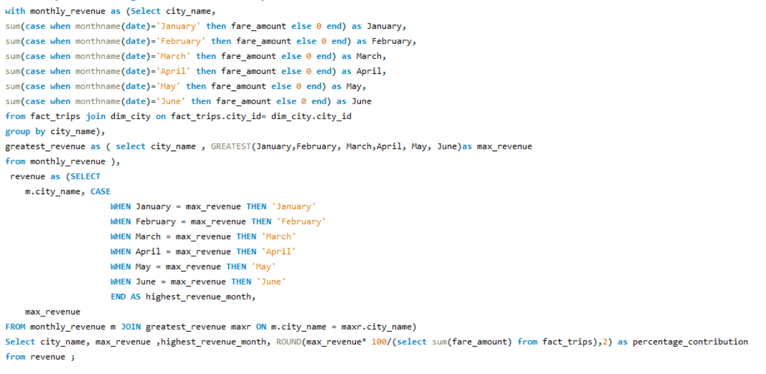
8.Month With Highest Revenue For Each City

Slide 15
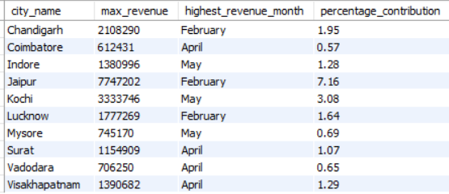
Output:

Slide 16
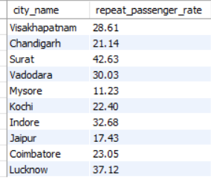
9.Monthly Repeat Passenger Rate
Output:

Slide 17
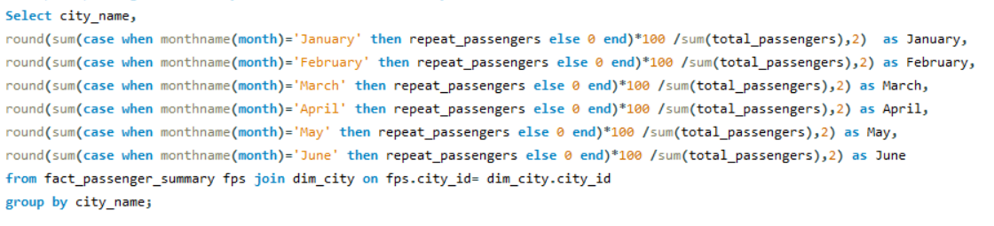
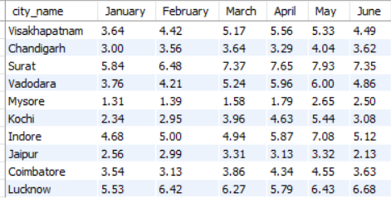
10. City-wide Repeat Passenger Rate
Output:

Slide 18
Dashboard Showcase

Slide 19


Slide 20
Insights
Trip Insights
Jaipur, Lucknow & Surat are top 3 cities with highest number of trips. While Mysore, Coimbatore & Visakhapatnam are bottom 3 cities in terms of trips.
February witnessed the maximum trips around 17.7% of total trips during Jan-June.
Past passengers have significantly made 16.91% more number of trips as compared to new passenger.
Weekday’s have recorded maximum trips, estimated 55.86% of total trips.
There was a 0.7% shortfall in meeting the target total trips.

Slide 21
Insights
Passenger Specific Insights
New Passengers:
Maximum New passengers were observed in month of January & February.
Targeted new passengers were fulfilled only for April month and overall fell short by 4.4%.
New passengers have made their maximum trips on Weekends.
Repeat Passengers:
Repeat passenger rate is maximum in the month of June and in Surat.
Among repeat passengers, the 2-trip has the highest number of passengers(30.06% of total repeat passengers)
Repeat passengers have made their maximum trips on Weekdays.

Slide 22
Insights
Revenue Insights
Jaipur, Kochi & Chandigarh are the top 3 cities contributing maximum revenue , While Coimbatore, Vadodara & Mysore are bottom 3 cities in revenue contribution.
February month contributed maximum to revenue.
Weekend’s have witnessed significant revenue generation.
Average Trip cost is more than ₹ 280 in Jaipur, Kochi, Chandigarh & Visakhapatnam. Jaipur having the most expensive Trip cost which is ₹ 483 while Surat have least expensive trip cost which is mere ₹ 117.

Slide 23
Insights
Performance Insights
Goodcabs witnessed 16.5% monthly revenue growth rate. Out of all cities, Mysore have recorded highest monthly revenue growth rate which is 21.4%
Jaipur, Kochi & Mysore have received highest average driver rating and passenger rating.
The average target rating fell short by 3.9%.
Lucknow, Surat & Vadodara have got least average driver rating.

Slide 24
Insights
Factors Influencing Repeat Passenger Rate
The repeat passenger rate is influenced by factors such as city demographics, service quality, and competitive pricing.
The analysis confirms that Surat, Lucknow, and Indore have high repeat passenger rates, primarily due to these cities being industrial hubs with a higher number of daily commuters compared to tourist destinations.
Additionally, the trip cost is lower in these three cities.

Slide 25
Insights
Tourism vs Business Demand Impact
Based on total trip counts, Jaipur, Lucknow, and Surat have the highest number of trips.
In Jaipur, a tourism-focused city, most bookings are made by new passengers, with around 42% of trips being from first-time travelers.
Surat, a business-oriented city, primarily sees repeat passengers, indicating that most users are working professionals who rely on cab services for daily commuting.
Lucknow, which combines both business and tourism, has more repeat passengers than new ones, suggesting frequent use by working professionals. The city also attracts tourists, contributing to the total trip count.

Slide 26
Discount/Coupon codes
To attract more new passengers, should offer new user coupons that provide discounts on their first trip.
To boost repeat passenger rate, offer points per trip that can be redeemed for discounts in future booking.
Recommendations
Online Presence
Goodcabs should focus on building a strong online presence through social media platforms such as Facebook, Instagram, and Twitter. Engaging content, customer reviews, and special promotions can help build brand awareness and connect with potential passengers

Slide 27
Recommendations
Business Collaborations
Goodcabs should partner with local hotels, entertainment venues and malls to increase traffic and expand its reach By offering ride packages during hotel bookings, Goodcabs can provide added convenience for tourists.
Goodcabs could explore partnerships with corporate offices, offering customized transportation solutions for employees
Goodcabs should offer ride services at local events, festivals, and promotions, which can increase its visibility and attract more customers.

Slide 28
Recommendations
Data Collection
Goodcabs should gather more detailed data, such as the duration for which rides are booked, to better understand time-based trends.
Goodcabs should also collect data on passengers' preferred routes, frequent destinations, competitor pricing, and available offers to stay competitive
Additionally, analyzing demand in key areas like airports and popular tourist spots will help identify high-traffic zones and optimize service availability.

Slide 29



THANK YOU!
Ankit Rai
ankittrai0410@gmail.com
ankitrai259

